Slide 1
1863: Shifting Tides

Slide 2
Shifting Tides
Date | Battle Name | Winner
Sept 17, 1862 | Antietam a.k.a. Sharpsburg, MD
April 12-13, 1861 | Attack on Fort Sumter, SC
April 30-May 6, 1863 | Chancellorsville, VA
Feb 6-16 ,1862 | Fort Henry/Fort Donelson, TN
Dec 13, 1862 | Fredericksburg, VA
July 1-3, 1863 | Gettysburg, PA
March-June, 1862 | Jackson’s Valley Campaign, VA
July 21, 1861 | First Manassas a.k.a. Bull Run, VA
August 28-30, 1862 | Second Manassas a.k.a. Second Bull Run, VA
Oct 8, 1862 | Perryville, KY
April 6-7, 1862 | Shiloh a.k.a. Pittsburg Landing, TN
May 18 – July 4 1863 | Siege of Vicksburg, MS
Dec 31, 1862-Jan 2, 1863 | Stones River a.k.a. Murfreesboro, TN
At the top of your Timeline and Map Worksheet is a chart listing the battles including their location and date.

Slide 3
Activity Place the events on the timeline in chronological order.
1861
1863

Slide 4
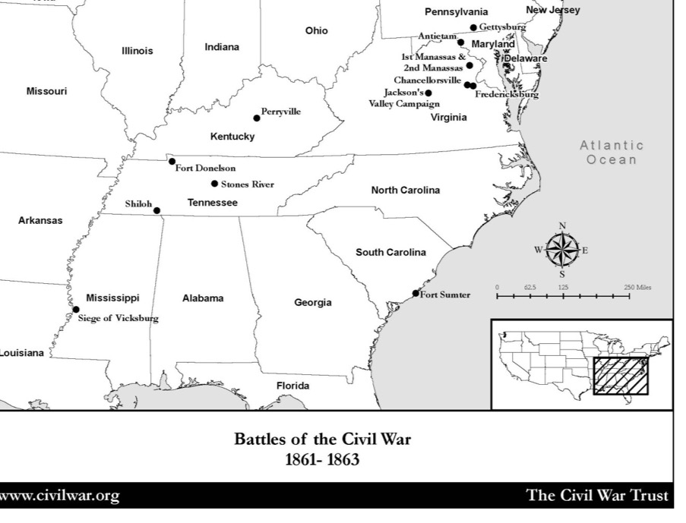
On the other side of your worksheet is a map showing the battles on your chart.

Slide 5
Activity: Shifting Tides
Each note card contains the following:
Name of the Battle
Date of the Battle
A Summary of the Battle
Battle Casualties
The Victor
Notes:
Place students with a partner and give them a note card containing facts about one of the battles on the chart.

Slide 6
Activity: Shifting Tides
Each team will come to the front of the room in chronological order.
One member of the team will point out the location of the battle on the projected map.
When the image of the battle is shown, the other member of the team will read the fact sheet.

Slide 7
Activity: Shifting Tides
Students in the audience:
Will locate the battle on their own map.
Depending on who won, draw a blue or grey star in that location.
Write the date of the battle.
On your chart on write down the winner, in the “winner” column.
When the map is complete, tally the victories for each side.

Slide 8
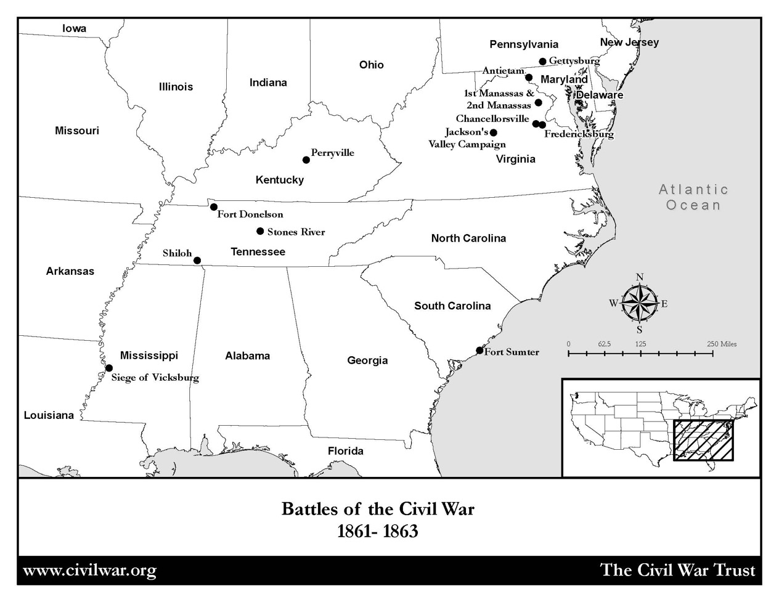
Notes:
First group on the timeline please come up and point out the location of the map of your battle.

Slide 9
Fort Sumter

Slide 10
Notes:
Second group on the timeline please come up and point out the location of the map of your battle.

Slide 11
First Manassas (Bull Run)
Notes:
Image information:
The ruins of Cub Run bridge after the battle, July 21, 1861.

Slide 12
Notes:
Third group on the timeline please come up and point out the location of the map of your battle.

Slide 13
Forts Henry and Donelson

Slide 14
Notes:
Fourth group on the timeline please come up and point out the location of the map of your battle.

Slide 15
Shiloh

Slide 16
Notes:
Fifth group on the timeline please come up and point out the location of the map of your battle.

Slide 17
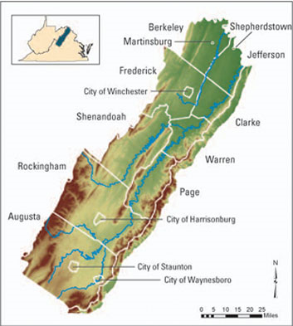
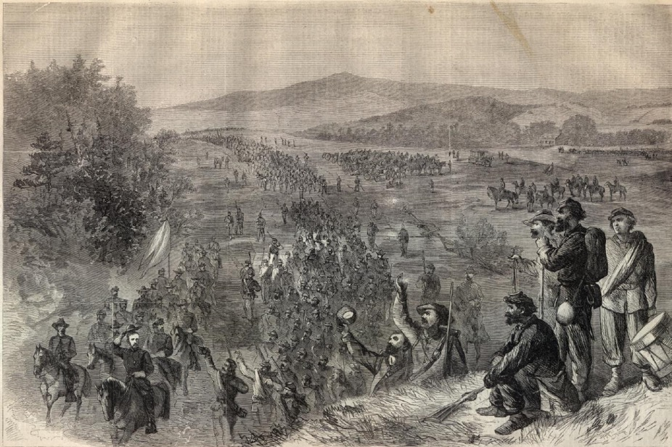
Stonewall Jackson’s Valley Campaign
Image courtesy of Harper’s Weekly

Slide 18
Notes:
Sixth group on the timeline please come up and point out the location of the map of your battle.

Slide 19
Second Manassas (Second Bull Run)

Slide 20
Notes:
Seventh group on the timeline please come up and point out the location of the map of your battle.

Slide 21
Antietam (Sharpsburg)

Slide 22
Notes:
Eighth group on the timeline please come up and point out the location of the map of your battle.

Slide 23
Perryville

Slide 24
Notes:
Ninth group on the timeline please come up and point out the location of the map of your battle.

Slide 25
Fredericksburg

Slide 26
Notes:
Tenth group on the timeline please come up and point out the location of the map of your battle.

Slide 27
Stones River (Murfreesboro)

Slide 28
Notes:
We’re temporarily skipping the beginning of the Vicksburg Campaign, so the next group on the timeline please come up and point out the location of the map of your battle.

Slide 29
Chancellorsville

Slide 30
Activity: Shifting Tides
Let’s take a moment to look at our maps and timeline.
Where are most of the Confederate victories?
Where are most of the United States’ victories?

Slide 31
Shifting Tides
Even though there were more Union victories in the west, many people placed more importance on the east because that is where the capitals of the United States and the Confederate States were located.

Slide 32
The Situation as the Summer of 1863 Arrives
In the West, United States military forces under Ulysses S. Grant have surrounded Vicksburg, Mississippi, which was a significant point that controlled access to the Mississippi River.

Slide 33
The Situation as the Summer of 1863 Arrives
Notes:
A loss at Vicksburg would mean that the Confederate territory would essentially be cut in half, making it difficult to send supplies and communicate with Confederate states or forces east of the river.

Slide 34
Notes:
Let’s have the Vicksburg group come up now.

Slide 35
Vicksburg

Slide 36
Vicksburg
After 47 days of bombardment Pemberton surrendered Vicksburg to Grant on July 4, 1863.

Slide 37
Vicksburg
Notes:
The last area controlled by Confederates on the Mississippi River, Port Hudson, fell to the Union a couple of days later. The United States was able to ship goods from the northern states down the Mississippi River to New Orleans

Slide 38
The Situation as the Summer of 1863 Arrives
In the east, Confederate forces under General Robert E. Lee invaded the northern state of Pennsylvania
Notes:
Image information:
View of Little Round Top, Gettysburg

Slide 39
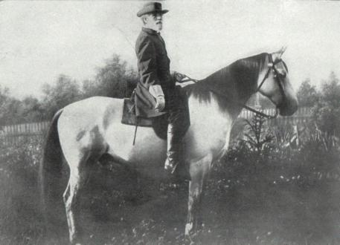
At this point in the war, the Confederate Army of Northern Virginia had a winning record. And Confederate General, Robert E. Lee had a plan to move his army north.
The Situation as the Summer of 1863 Arrives
Notes:
Image information:
Robert E. Lee on Traveller

Slide 40
Notes:
Let’s have the Gettysburg group come up now.

Slide 41
Gettysburg

Slide 42
Gettysburg
5 reasons Lee invaded Pennsylvania :
to disrupt the Union’s ability to attack the Confederate capital at Richmond, Virginia
to draw the United States Army away from the safety of the defenses of Washington, D.C. and fight them in the “open”
to take the war away from the farmers in Virginia who were having problems planting and harvesting crops, as both armies had been camping or fighting on their land for the previous two summers
to “live off the land” and collect supplies to take back to Virginia
to win a decisive victory on Northern soil in the hopes of bringing the Civil War to a close

Slide 43
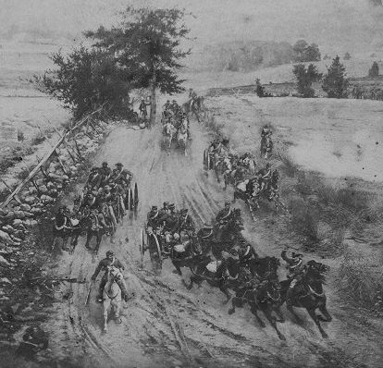
Gettysburg
On July 1st, 1863 Union forces clashed with Lee’s Army

Slide 44
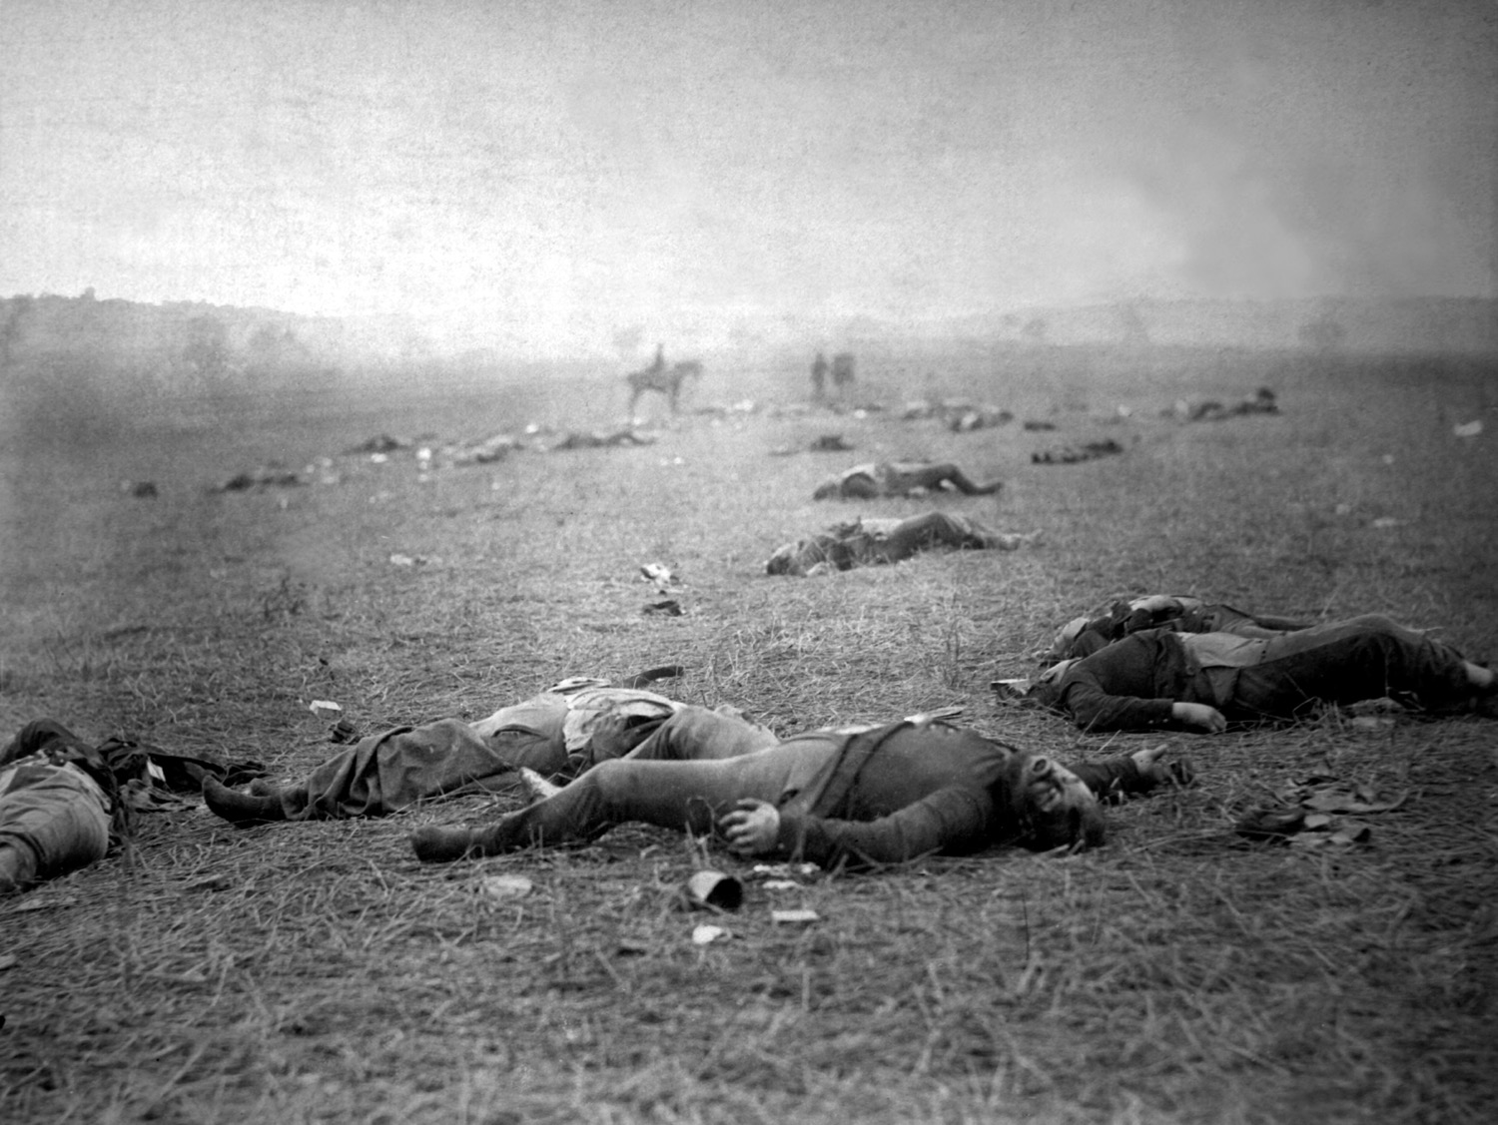
After three days of fighting July 1-3, 1863… Image courtesy Library of Congress

Slide 45
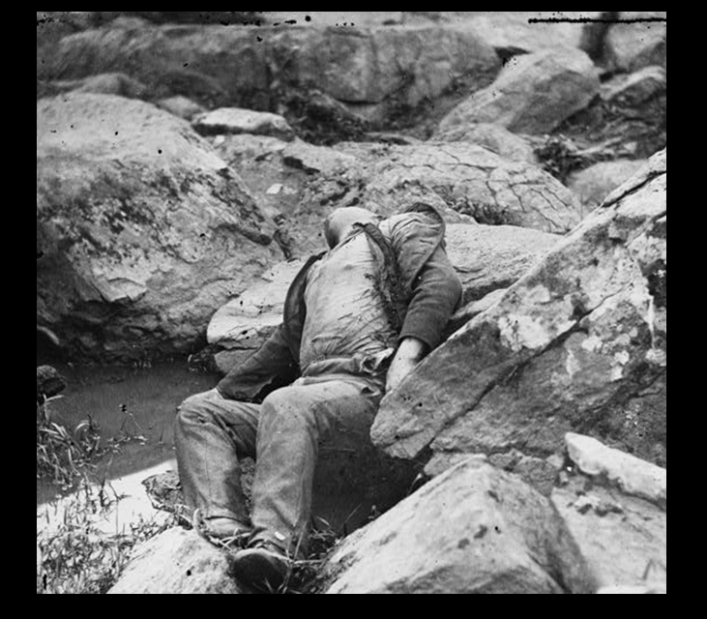
… and 51,000 casualties killed, wounded, or missing Image courtesy Library of Congress

Slide 46
Lee and his army left Pennsylvania and retreated back to Virginia. Never again would the Confederates invade a Northern state in large numbers.
Gettysburg
The Confederate Army of Northern Virginia was defeated

Slide 47
The Aftermath
In the United States
The victories at Gettysburg and Vicksburg increased the morale of the United States and its armies. Many people now felt that the war might be won.
In the Confederate States
The losses at Vicksburg and Gettysburg decreased the morale of the Confederate States and its armies.
For most of the remainder of the war the Confederates would be fighting on the defensive.

Slide 48
The Aftermath
Back at Gettysburg, the dead were buried in quickly dug battlefield graves.

Slide 49
The Aftermath
Most of the Confederate dead were left on the field in their shallow graves for eight to ten years until southern charity groups had most of the bodies taken away to cemeteries in the South.

Slide 50
The Aftermath
On November 19, 1863, a Soldiers’ National Cemetery was established at Gettysburg for the Union dead.

Slide 51
The Aftermath
Music was played and speeches were made, but the most significant speech, lasting approximately two minutes, was made by President Abraham Lincoln.

Slide 52
Activity Let’s read the Gettysburg Address together.
The Aftermath

Slide 53
Discussion
“Four score and seven years ago” refers to what year?
What happened in United States’ history during that year?
For what cause(s) did President Lincoln believe the United States’ soldiers were fighting during the American Civil War?
How can the nation make sure that free governments (democracies) “shall not perish from the earth?”
What did the American people have to do to make sure that the United States’ soldiers who were killed in the War had not died “in vain?”
What do you think Lincoln means by the phrase “…government of the people, by the people, for the people…?”
Notes:
After reading and discussing Lincoln’s Gettysburg Address, discuss the questions on this slide.

