Slide 1
1864-1865: Bringing the War to an End

Slide 2
Bringing the War to an End
Notes:
At this point the situation is looking up for the United States with victories at Vicksburg and Gettysburg; but some people are tired of war and looking for a way to end it soon.
Lincoln has served four years as President, one term.
Discussion: How do you think the election is going to go? Do you think people will reelect Lincoln or go with someone else? While Lincoln believes that it is important to keep fighting to bring the Southern States back what do you think his opponent believes?

Slide 3
Election of 1864
Notes:
With the war raging and the fate of the country hanging in the balance, the 1864 election had particular significance. Abraham Lincoln sought reelection in his campaign against former Union General George B. McClellan.
Image information:
Left – Democratic Candidates
Right – Republican Candidates

Slide 4
Election of 1864
Abraham Lincoln argued that the war must be won, the slaves freed, and the Union preserved at all costs.
George McClellan argued that the war had gone on long enough and that the South should be allowed to secede in order to save American lives. This meant that slavery would continue in the Southern states.
Notes:
Abraham Lincoln argued that the war must be won, the slaves freed, and the Union preserved at all costs.
McClellan argued that the war had gone on long enough and that the South should be allowed to secede in order to save American lives. This meant that slavery would continue in the Southern states.

Slide 5
Election of 1864
Image courtesy of the Library of Congress
Notes:
At this time in the war, many Americans asked why the war was being fought and whether it was worth it.

Slide 6
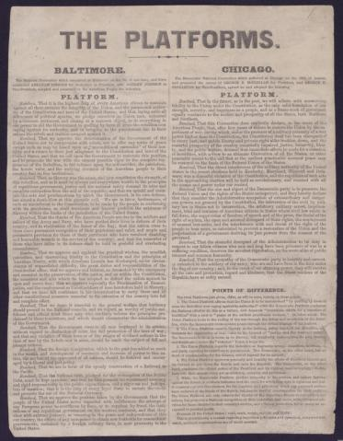
Election of 1864
Activity
Students considering the war from the perspective of Abraham Lincoln will read the Baltimore Platform

Slide 7
Election of 1864
Activity
Students considering the war from the perspective of George B. McClellan will read the Chicago Platform

Slide 8
What do you think?
Not knowing who will win or lose, is it worth continuing the war, no matter how many casualties?
You will now break into two groups. Group 1 – Lincoln Group 2 – McClellan
Read your platform as a group.

Slide 9
What do you Think?
If you were Lincoln and chose to continue fighting the war…
How will you win?
Will you continue to try to spare civilians as the war wages around them?
How will you persuade the Northern public to support the effort?
How will you persuade Congress to financially support the war effort?
If you win, will you punish all of the people of the Confederacy or just those who “took up arms” against the United States or neither? (How will you be able to tell the difference?)
Notes:
After reading the platforms consider the following military, political, and economic factors

Slide 10
What do you Think?
If you were McClellan and chose NOT to continue the war…
How will you defend your new southern border?
How will you address the issue of runaway slaves from the South?
Will you enact a law similar to the Fugitive Slave Act in order to appease the new southern Confederacy?
How will you deal with the expanding western border and the current U.S. territories such as Oregon and Oklahoma?

Slide 11
What do you Think?
Activity Now, we will have a group debate between the Lincolns and McClellans
Notes:
Debate Questions:
Mr. Lincoln – How do you suppose we will win this war?
Mr. McClellan – Do you think we can win the war? What would you like to do instead of fight the war?
Mr. McClellan – If we end the war and allow slavery to continue in the South, do we still have to return runaway slaves?
Mr. Lincoln & Mr. McClellan – What do you think the nation wants right now?

Slide 12
What do you Think
Raise your hand if you are voting for Lincoln.
Raise your hand if you are voting for McClellan.

Slide 13
What do you Think?
America chose, through the election of Abraham Lincoln, to continue fighting the war.

Slide 14
Bringing the War to an End
Abraham Lincoln appointed Ulysses S. Grant as commander of all the U.S. forces.
Image courtesy of the Library of Congress

Slide 15
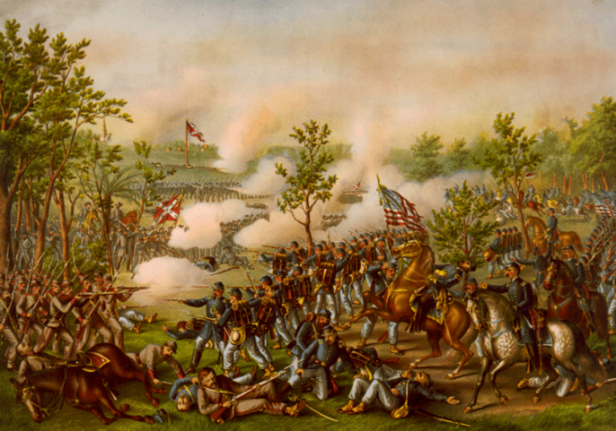
Bringing the War to an End
Notes:
Grant decided to fight the war on five fronts, with the biggest numbers toward Richmond and Atlanta.

Slide 16
Timeline and Map
Activity
Using your Timeline and Map worksheet, create a timeline of events leading up to the end of the Civil War.
On the back of the page, plot the battles and in some cases, routes. Write battle names and dates on your map.
Answer the question underneath your map: By attacking on both ends what do you think Grant was hoping to do to the Confederacy?

Slide 17
Confederate Surrender
The armies of the Union were able to coordinate successfully with each other and Lee surrendered at Appomattox, Virginia on April 9, 1865.
Find Appomattox on your map and label it, Confederate surrender.
Image courtesy of the National Park Service

Slide 18
Confederate Surrender
“With an increasing admiration of your constancy and devotion to your country, and a grateful remembrance of your kind and generous consideration for myself, I bid you all an affectionate farewell”
- Robert E. Lee

Slide 19
Confederate Surrender
“…not a sound of trumpet more, nor roll of drum; not a cheer, nor word, nor whisper of vain-glorying, nor motion of man standing again at the order, but an awed stillness rather, and breath-holding, as if it were the passing of the dead.” -Joshua Lawrence Chamberlain
Notes:
Discussion:
Based on the quote from Lee, quote from Chamberlain, and the Articles of Agreement, how do you think the US forces felt about the Confederate forces at the end of the war?

Slide 20
Johnston Surrenders to Sherman
Johnston surrendered to Sherman on April 26, 1865 in the home of James Bennett near Durham, North Carolina.

Slide 21
Rebuilding
After the surrender, the difficult task of rebuilding and reunifying the country began.
Image courtesy of the National Archives
Notes:
Image information:
Richmond in ruins.

